Slide 1
Airline Safety Data
Using Data Presentation and
Visualization to Explore Flight Safety
Notes:
Flying has long been considered one of the safest ways to travel — particularly when compared to automobiles. However, because of recent unfortunate airline crashes, it is now being presented to the public as one of the most dangerous. In fact, numerous media outlets around the country have been touting statistics stating that flying is no longer a safe way of traveling. News and media outlets have bombarded the public with statistics and figures about airline safety trends, and are reporting, overall, that things do not look good for the industry. With that narrative in mind, a study was undertaken to look into historical data of airline and automobile incidents, crashes, and fatalities, and also to dig deeper into the underlying factors of the most recent airline crashes, to truly understand if what is being presented by the media is accurate.
This presentation will focus on the safety of airline travel and whether more recent crashes are a cause for concern for both the airline industry and the general public. The primary objective of this presentation is to show the data’s findings — the data story — in a manner that can be easily consumed and understood by everyone, from business executives making decisions involving billions of dollars about their airlines, to the average individual wanting to make a personal decision about whether they will be safe if they choose to book a ticket and fly to visit family.

Slide 2
Notes:
Recent airline events have caused a lot of discussion and media reporting that flying is no longer safe, that it is dangerous, and that there is a lot of risk involved with getting on an airplane. Is this true? To verify if these claims are accurate, I looked at thirty-six years of data from the Aviation Safety Network, the National Highway Traffic Safety Administration, and the National Safety Council. Add in more information here.
As I began looking into the historical accident and fatalities numbers across both airline and automobile industries, a different story than the one being reported started to unfold.

Slide 3
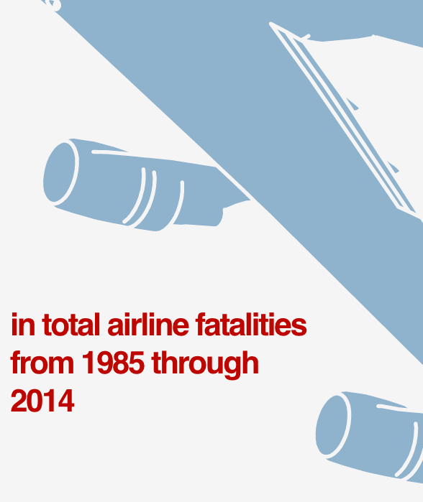
Notes:
Covering a 30-year span from 1985 through 2014, we have three sets of airline-related data to look at here.
The first one shows that the total number of airline fatalities over this thirty years has decreased by 51%. That’s a pretty remarkable number. In correlation with the fatalities number, the total number of airline incidents also decreased by 43%. Looking at the total number of fatal accidents in the airline industry there was a huge decrease from 122 down to 37, a decrease of 70%. What do these numbers mean? The data is telling us that it is actually getting safer to fly.

Slide 4
Notes:
If the statistics are showing that it is getting safer to fly, why is there all of this recent panic? One faulty component on a new aircraft is why.
Let’s get into the recent events that are the primary source of this fear of flying — the deaths related to Boeing’s 737 MAX aircraft. The 346 fatalities from this particular aircraft came from two different flights less than six months apart, each from different airlines. Their common bond is the flaw in the aircraft’s hardware and software system (MCAS) — which stands for maneuvering characteristics augmentation system — that automatically control the pitch of the aircraft if it detects a stall position (for example one where the plane is climbing at a higher angle, usually in takeoff situations). The MCAS hardware and software combination was faulty, causing the 737 MAX planes to override pilot control, automatically and continuously driving the nose of the plane down, causing them to crash. Not long after the second incident of a Boeing 737 MAX aircraft, the entire fleet was grounded. The crashes of these particular aircrafts from Boeing are the primary reason for the cause of panic regarding flying and these crashes are extremely atypical of the industry at large.

Slide 5
Notes:
From 1985 through 2020, there were an unfortunate total of just over 1.4 million fatalities from automobile and airline crashes. This is a devastating number, and it is painful to have these number be anything other than zero. Digging into the data behind these fatalities numbers, something rather interesting jumps out.

Slide 6
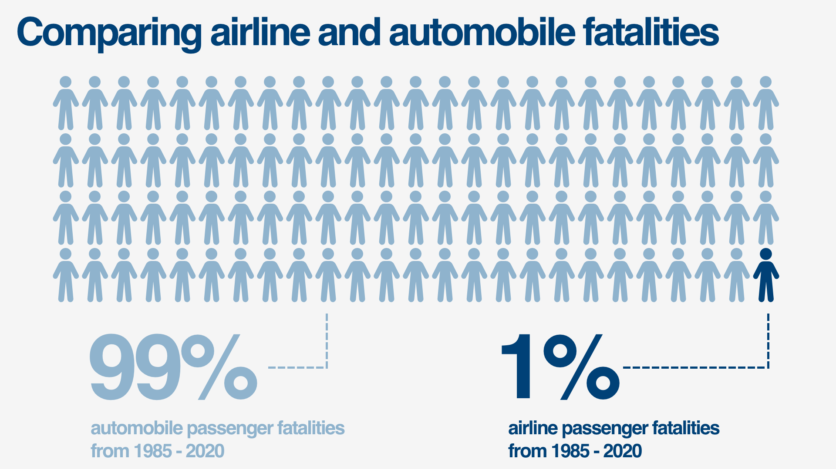
Notes:
Of those total fatalities…11,498 were airline-related. That comes out to less than one percent, at 0.8%. While the perception might be that flying isn’t safe, the data shows that flying is much safer than driving.

Slide 7
Notes:
Insert narration here.

Slide 8
Notes:
The last set of data to talk about regarding airline safety is a bit morbid, but as human beings we are prone to contemplate our own demise. That is why we tend to make decisions attempt to maximize our life expectancy. Let’s explore the odds of dying in an automobile accident versus an airplane accident.

Slide 9
Notes:
Any guesses as to what these numbers will be? Let’s dive into the data.
According to the numbers, as you can see, the odds of dying as a driver in an automobile accident are 1 in 114. This data mostly reflects single-occupant vehicular accidents. The graphic on the right is for automobile passenger data, and it shows that the odds of dying as a passenger in an automobile accident are 1 in 645.

Slide 10
Notes:
That brings us to the odds of dying in an airplane accident. This graphic needed its own screen. As you can see here, the odds of dying in an airplane accident are 1 in 9,821.
To wrap things up… while the recent events of Boeing’s 737 MAX airplanes have caused a lot of panic about the safety of flying, the data shows that airline incidents and fatalities have actually been on the decline and statistically you are much safer in an airplane than an automobile.

Slide 11
Notes:
Just recently, some startling numbers came out pertaining to last year that really put things into perspective regarding the contrast between safety statistics for airplanes versus automobiles. As well all know, the world changed dramatically in 2020 in response to the outbreak of COVID-19. Businesses, schools, and homes were forced to lock down for long stretches at a time throughout 2020 to help contain the spread of the virus. As a good portion of office workers began to work from home, the amount of traffic on roads within the United States dropped dramatically. That would lead you to believe that there would be far fewer automobile crashes in 2020 since there were less people and vehicles on the road, right?

Slide 12
Notes:
Unfortunately, the numbers here are actually very different than one would think. Motor vehicle deaths jumped 8% in 2020, despite fewer people on the roads amid the COVID-19 pandemic, according to preliminary data from the National Safety Council. The NSC, a nonprofit focused on promoting safety in the United States, said despite a 13% drop in miles driven in 2020, the estimated rate of death on the roads last year spiked 24% over the previous 12-month period.
Preliminary data from the NSC showed as many as 42,060 people died in motor vehicle crashes in 2020 -- compared to 39,107 deaths due to motor vehicle accidents in 2019. Seven states and the District of Columbia saw more than a 15% increase in the estimated number of deaths last year -- this includes Arkansas, Connecticut, Georgia, Mississippi, Rhode Island, South Dakota and Vermont. Connecticut’s transportation department said preliminarily data show 310 crash deaths in 2020, a 24% increase. Like most of the nation, Connecticut has seen more reckless, dangerous and irresponsible driving, a department spokesman said. The state agency is backing bills in the legislature aimed at expanding seat belt requirements and improving pedestrian safety, he said.

Slide 13
Notes:
In conclusion, based upon the findings of thirty-six years of data, despite recent fears of flying, with the exception of a faulty hardware and software system on one particular aircraft (Boeing’s 737 MAX), traveling by plane is still extremely safe compared to other methods of travel.
Airlines that had incidents or fatal crashes in the past are not necessarily prone to have them happen again. Also, the data shows that the number of incidents and fatalities over 30 years have dropped quite a bit, and they are not particular to one geographic location, though there is evidence that airlines from developing countries are more prone to incidents, accidents, and fatalities.
Comparing the fatalities of airline travelers and those in automobiles provides a rather telling statistic: between the years of 1985 and 2020, the total number of fatalities from airline and auto crashes was 1,437,182. Of that number, airline fatalities make up only one percent of that total. Flying continues to be one of the safest methods of getting from one location to another.

